Slide 1
A Leap for Mankind
Valentina, Ryan, Matt, Josiah

Slide 2
Goals of Project
To show participants how different technologies can work together to create a seamless experience, and guide students through the steps needed to create their own simple racing game.
Students should feel a sense of accomplishment and excitement when they are finished.

Slide 3
Project set up
Each demo workstation will have to have internet access to use ScratchX, the Leap Motion browser extension, the Leap Motion controller, and the Leap Motion driver installed on the computer.
ScratchX with Leap Motion Extension
(Scratch 3.0 no longer supports experimental extensions)
ScratchX with LeapMotion Extension
Scratch Extension Browser Plugin
Scratch Leap Motion Extension
Leap Motion Driver Downloads (v2 for Legacy support?)

Slide 4
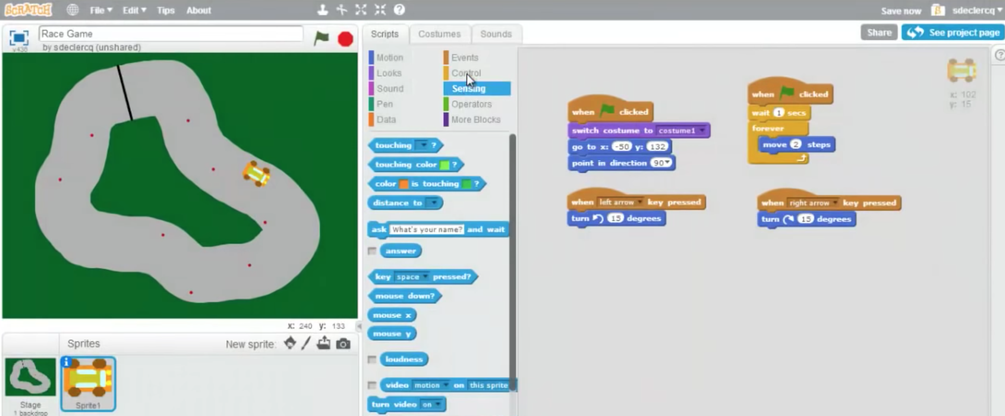
Participation
Each of the students will learn to program their own simple overhead racing game, complete with obstacles, power-ups, and more.
They will then be able to play other harder tracks that were created by our group, using the Leap Motion controller that will be integrated with the game. There will be a time / scoring system to determine a winner.

Slide 5



Technologies
Scratch Programming Language
Leap Motion Controller
ScratchX with Leap Motion Extension
(Scratch 3.0 no longer supports experimental extensions)
ScratchX with LeapMotion Extension
Scratch Extension Browser Plugin
Scratch Leap Motion Extension
Leap Motion Driver Downloads (v2 for Legacy support?)

Slide 6

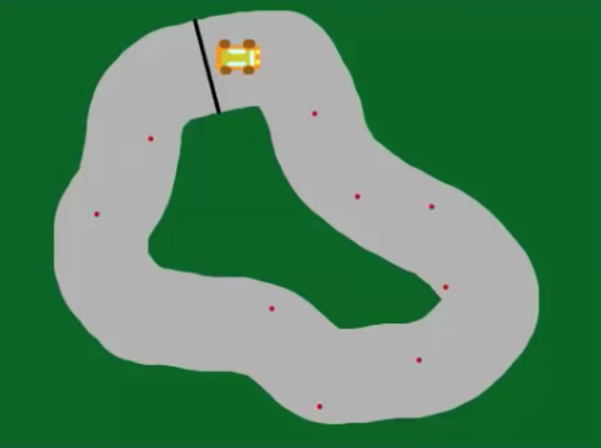
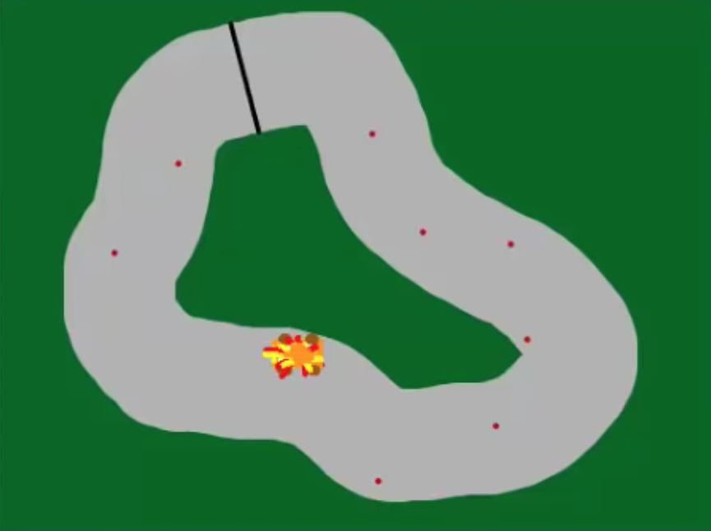
Racing Game
Create a top-down racing game using Scratch and Leap Motion.
Create custom obstacles and power-ups
Include a ”ghost car” to chase the player.
Detect when player collides with the sides of the track or with obstacles and stop the game.
May have to pick and choose which features to include in the tracks that the students build, based on time constraints.

Slide 7
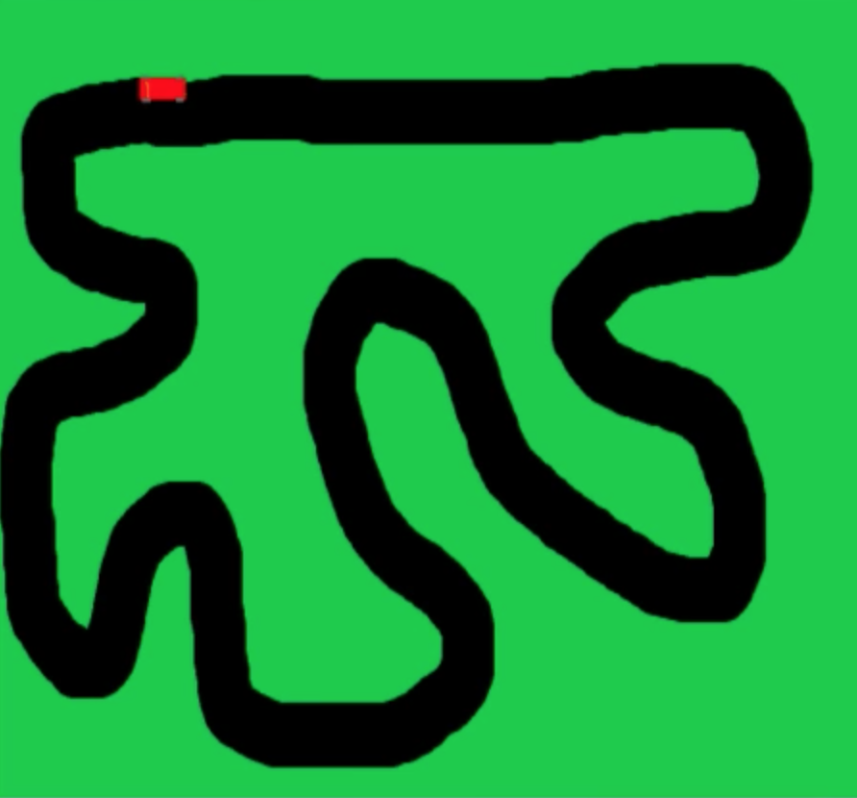
Different Tracks
Easy
Participants will help create this track and code (hands-on)
Medium
Faster car speed and more turns and obstacles
Hard
Fastest speed and almost impossible to finish with all the obstacles

Slide 8

Challenges
Time management to organize the workshops successfully.
We are new to Scratch development / not sure if there will be any unforeseen obstacles or limits when integrating Scratch with the Leap Motion controller

